Slide 1
FOOD WASTE MANAGEMENT AND DONATION APPLICATION

Slide 2


ARTIFICIAL INTELLIGENCE & MACHINE LEARNING:-
K. BHUPATHI REDDY-21BK5A6604(3RD AI-ML)
G.NIHAL REDDY-20BK1A6621(3RD AI-ML)
D.GOUTAM RAJU-20BK1A6617(3RD AI-ML
E.NITHIN -20BK1A6618(3RD AI-ML)

Slide 3
INTRODUCTION
THIS ANDROID BASED FOOD WASTE AND MANAGEMENT SYSTEM CAN ASSIST IN COLLECTING THE LEFTOVER FOOD FROM RESTAUTRANTS TO DISTRIBUTE AMONG THOSE IN NEED.
NGO’S THAT ARE HELPING POOR COMMUNITIES TO BATTLE AGAINST STARVATION AND MALNUTRITION CAN RAISE A REQUEST FOR FOOD SUPPLY FROM RESTAURANTS THROUGH THIS APP.
IN THIS SYSTEM ,WE HAVE TRIED TO REDUCE RESTAURANT FOOD WASTAGE BY GIVING LEFT OVER FOOD TO NGO’S AT THE END OF THE DAY
ADMIN CAN TRACK THE HISTORY OF RESTAURANTS AND NGOS FOR THE LEFTOVER FOODS

Slide 4
MODULES
LOGIN AND REGISTRATION:IT INVOLVES LOGIN AND REGISTRATION FOR BOTH THE GUEST AND AGENT.
NOTIFICATION:IT SENDS THE NOTIFICATIONTO TO THE AGENT BY THE GUEST(the user will send the notification which contains the location of food available , this is achieved by notification button)
ADMIN:ADMINISTRATOR MAINTINS THE AGENT DETAILS AS WELL AS DONOR DETAILS(administrator collects the food from the agent and gives the orphanage details directly to donor)
DONOR:DONOR GIVES THE WASTAGE FOOD TO ORPANAGE.(donor views the orphanage details and agent details)
RECIEVER:RECIEVER MAINTAINS THE ORPHANAGE DETAILS.(it gives the request to admin to collect the food from donor,after the collection the agent gives the alert message to the donor)

Slide 5
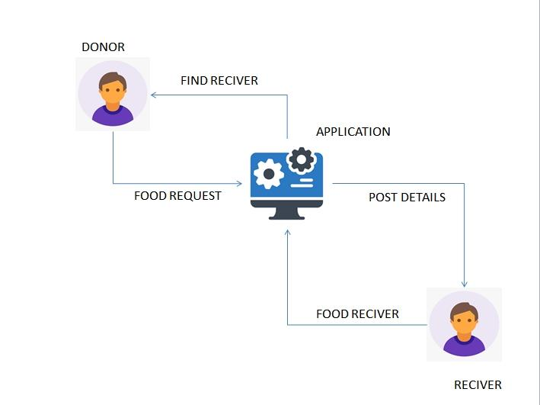
SYSTEM ARCHITECTURE

Slide 6
SOFTWARE AND HARDWARE REQUIREMENTS
SOFTWARE REQUIREMENT
HARDWARE REQUIREMENT
WINDOWS 11
JAVA
ANDROID STUDIOS
I5 PROCESSOR
4GB RAM
512SSD

Slide 7
DATABASE TABLE
TABLE NAME | PURPOSE
LOGIN AND REGISTRATION NOTIFICATION ADMIN DOMAIN RECIEVER | LOGIN AND REGISTRATION FOR BOTH THE GUEST AND AGENT SENDS NOTIFICATION TO THE AGENT BY THE GUEST ADMINISTRATOR MAINTAINS THE AGENT DETAIL AS WELL AS DONOR DETAIL DONOR GIVES THE WASTAGE FOOD TO THE ORPANAGE RECIEVER MAINTAINS THE ORPANAGE DETAILS
TABLE NAME
PURPOSE
LOGIN AND REGISTRATION
NOTIFICATION
ADMIN
DOMAIN
RECIEVER
LOGIN AND REGISTRATION FOR BOTH THE GUEST AND AGENT
SENDS NOTIFICATION TO THE AGENT BY THE GUEST
ADMINISTRATOR MAINTAINS THE AGENT DETAIL AS WELL AS DONOR DETAIL
DONOR GIVES THE WASTAGE FOOD TO THE ORPANAGE
RECIEVER MAINTAINS THE ORPANAGE DETAILS

Slide 8
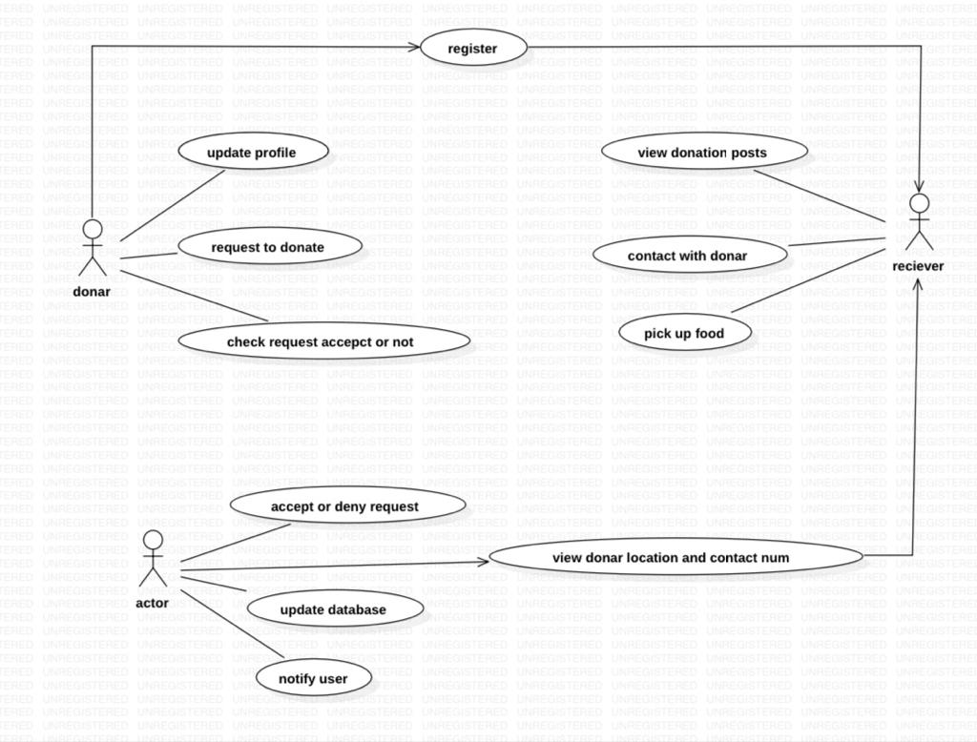
UML DIAGRAMS
USE CASE DIAGRAM

Slide 9
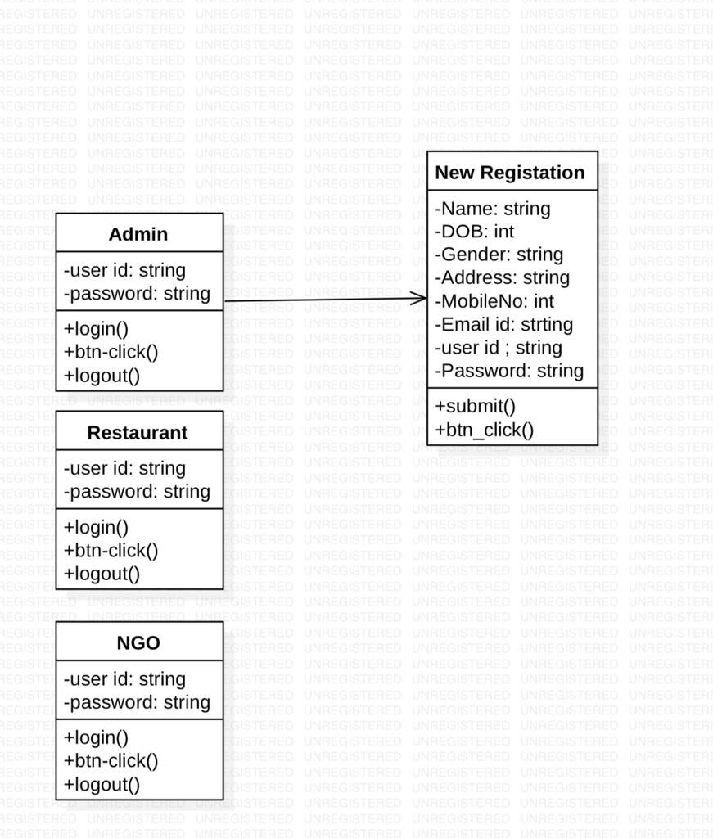
CLASS DIAGRAM

Slide 10
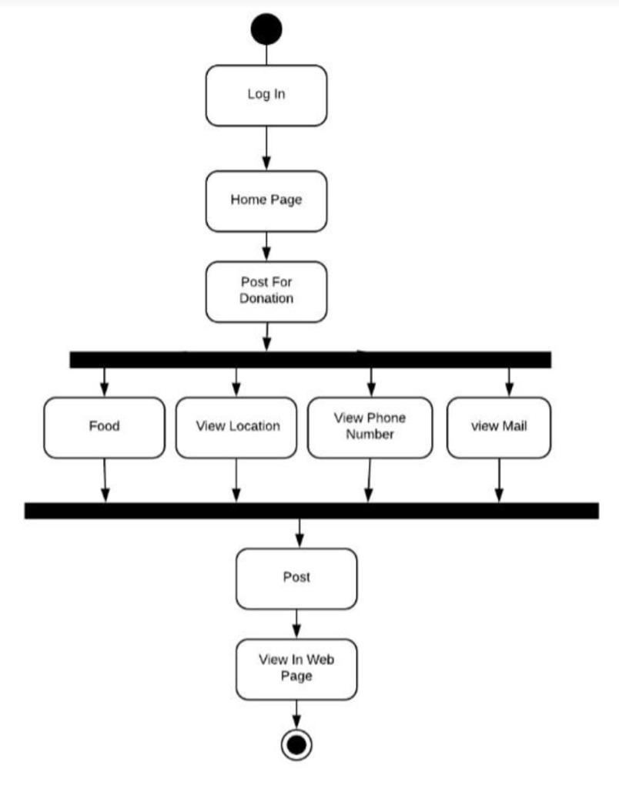
ACTIVITY DIAGRAM

Slide 11
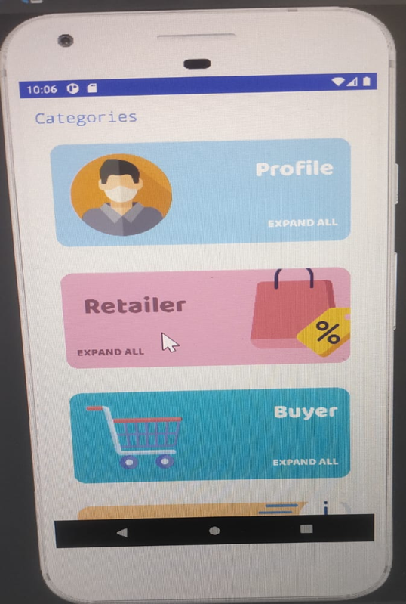

OUTPUT :- HOME PAGE PEOFILE LOGIN

Slide 12
CONCLUSION
THIS PROJECTS AIM IS TO HELP THE NEEDY BY CONNECTING THEM WITH THE DONORS BY USING THE NGO’S AS AN INTERMEDIARY
THIS APPLICATION WORKS PROPERLY AND RESPONSIVE TO THE USERS WITH PROPER RETRIEVAL FROM THE DATABASE,IN THIS WAY,THIS APPLICATION COMES WITH VARIOUS FEATURES FOR THE EFFECTIVE CONSUMPTION OF WASTE FOOD BY THE NEEDY PEOPLE

Slide 13


